Slide 1
Buda Tech
Power in Watts to dBm
$$P\left(dBm\right)=10\log_{10}^{P\left(W\right)}{+}30$$

Slide 2
Power in Watts conversion to Power in dBm
Buda Tech
dBm (decibel-milliwatts) is a unit that expresses signal strength or power levels, particularly in fields like radio, microwave, and fiber optics. It's a logarithmic scale, relative to one milliwatt (mw),
$$P\left(dBm\right)=10\log_{10}^{P\left(W\right)}{+}30$$

Slide 3

Buda Tech
Convert 50Watts to dBm
$$P\left(dBm\right)=10\log_{10}^{50}{+}30$$
$$P\left(dBm\right)=10(\frac{\log{50}}{\log{10}})+30$$

Slide 4

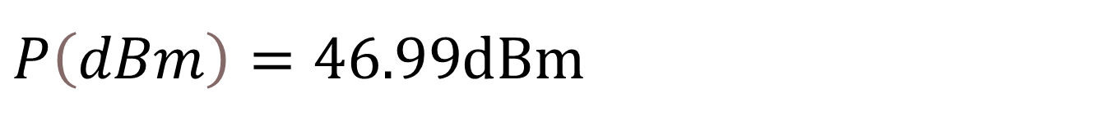

Buda Tech
Convert 50Watts to dBm
$$P\left(dBm\right)=10(\frac{\log{50}}{\log{10}})+30$$
$$P\left(dBm\right)=10(1.69897)+30$$
$P\left(dBm\right)=46.99$dBm

Slide 5
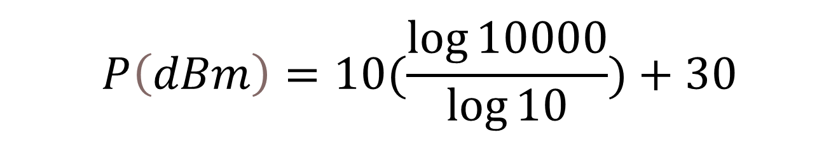
Buda Tech
Convert 10Kw to dBm
1kw =1000W
10kw = 10000W
$$P\left(dBm\right)=10\log_{10}^{10000}{+}30$$
$$P\left(dBm\right)=10(\frac{\log{10000}}{\log{10}})+30$$

Slide 6

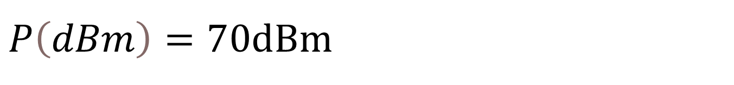
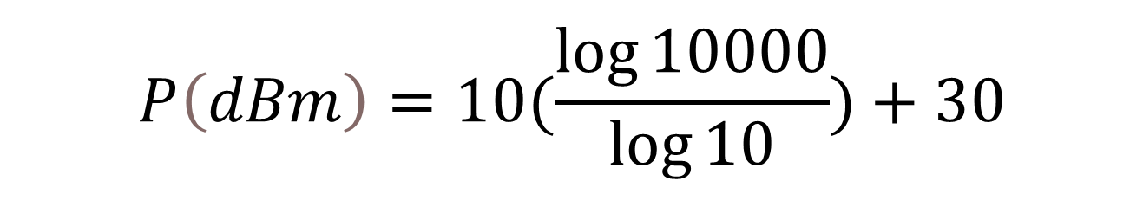
Buda Tech
Convert 10Kw to dBm
$$P\left(dBm\right)=10(\frac{\log{10000}}{\log{10}})+30$$
$$P\left(dBm\right)=10(4)+30$$
$P\left(dBm\right)=70$dBm

Slide 7

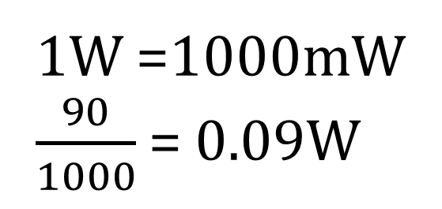
Buda Tech
Convert 90mW to dBm
1W =1000mW
$\frac{90}{1000}$ = 0.09W
$$P\left(dBm\right)=10\log_{10}^{0.09}{+}30$$
$$P\left(dBm\right)=10(\frac{\log{0.09}}{\log{10}})+30$$

Slide 8
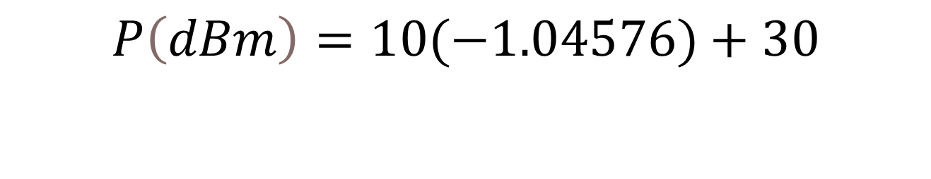


Buda Tech
Convert 90mW to dBm
$$P\left(dBm\right)=10(\frac{\log{0.09}}{\log{10}})+30$$
$$P\left(dBm\right)=10(−1.04576)+30$$
$P\left(dBm\right)=19.54$dBm

Slide 9

Buda Tech
Power in dBm to Watts
$$P\left(w\right)={10}^{\left(\frac{P\left(dBm\right)−30}{10}\right)}$$

Slide 10

Power in dBm conversion to Power in Watts
Buda Tech
dBm (decibel-milliwatts) is a unit that expresses signal strength or power levels, particularly in fields like radio, microwave, and fiber optics. It's a logarithmic scale, relative to one milliwatt (mw),
$$P\left(w\right)={10}^{\left(\frac{P\left(dBm\right)−30}{10}\right)}$$
$$P\left(dBm\right)=10\log_{10}^{P\left(W\right)}{+}30$$

Slide 11
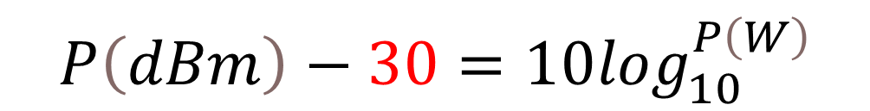
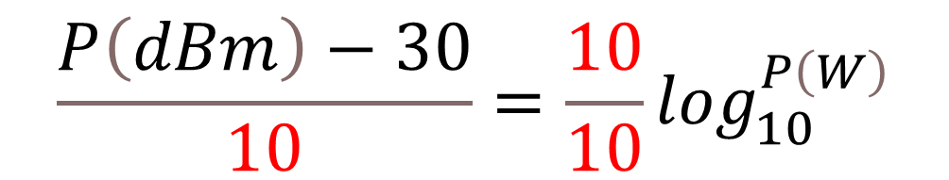
Formula
Buda Tech
From
$$P\left(dBm\right)=10\log_{10}^{P\left(W\right)}{+}30$$
$$P\left(dBm\right)−30=10\log_{10}^{P\left(W\right)}$$
$$\frac{P\left(dBm\right)−30}{10}=\frac{10}{10}\log_{10}^{P\left(W\right)}$$

Slide 12
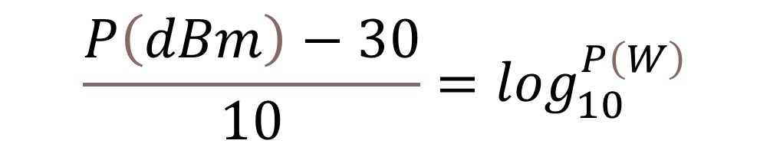

Formula
Buda Tech
$$\frac{P\left(dBm\right)−30}{10}=\frac{10}{10}\log_{10}^{P\left(W\right)}$$
$$\frac{P\left(dBm\right)−30}{10}=\log_{10}^{P\left(W\right)}$$

Slide 13
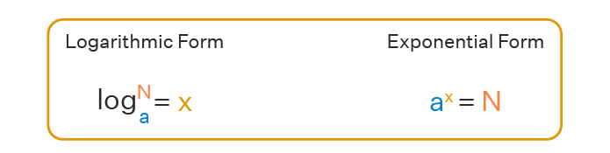


Formula
Buda Tech
$$\frac{P\left(dBm\right)−30}{10}=\log_{10}^{P\left(W\right)}$$
$$P\left(w\right)={10}^{\left(\frac{P\left(dBm\right)−30}{10}\right)}$$

Slide 14



Buda Tech
Convert 47dBm to Watts
$$P\left(w\right)={10}^{\left(\frac{P\left(dBm\right)−30}{10}\right)}$$
$$P\left(w\right)={10}^{\left(\frac{47 − 30}{10}\right)}$$
$P\left(w\right)={10}^{\left(\frac{17}{10}\right)}$ = ${10}^{\left(1.7\right)}$
$$P\left(w\right)=50Watts$$

Slide 15


Buda Tech
Convert 70 dBm to Watts
$$P\left(w\right)={10}^{\left(\frac{P\left(dBm\right)−30}{10}\right)}$$
$$P\left(w\right)={10}^{\left(\frac{70 − 30}{10}\right)}$$
$P\left(w\right)={10}^{\left(\frac{40}{10}\right)}$ = ${10}^{\left(4\right)}$
$$P\left(w\right)=10000Watts$$

Slide 16


Buda Tech
Convert 20 dBm to Watts
$$P\left(w\right)={10}^{\left(\frac{P\left(dBm\right)−30}{10}\right)}$$
$$P\left(w\right)={10}^{\left(\frac{20 − 30}{10}\right)}$$
$P\left(w\right)={10}^{\left(\frac{−10}{10}\right)}$ = ${10}^{\left(−1\right)}$
$$P\left(w\right)=0.1Watt$$

Slide 17


Buda Tech
Power Gain, Attenuation
& decibel dB
Gain $\left(dB\right)=10 \log_{10}^{\left(\frac{P(W)}{1W}\right)}$
Gain $\left(dB\right)=10 \log_{10}^{\left(\frac{Pout}{Pin}\right)}$

Slide 18
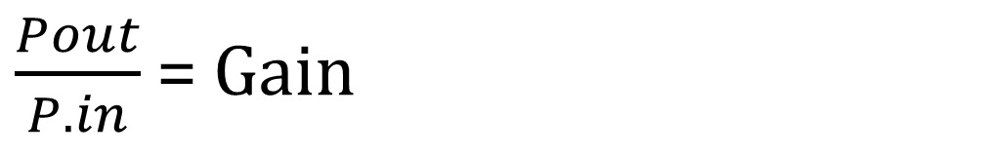
Buda Tech
Gain is the ratio of output power to input power
$\frac{Pout}{P.in}$ = Gain
Pin
Pout
Amplification

Slide 19

Buda Tech
Example: Input power is 75 mW, output power is 6W, what is the gain in dBW?
From
Gain $\left(dB\right)=10 \log_{10}^{\left(\frac{Pout}{Pin}\right)}$
Data Pin = 75mW
Pout = 6W

Slide 20

Buda Tech
Data Pin =75mW
1W = 1000mW
Pin = 0.075W
Pout = 6W
Gain $\left(dB\right)=10 \log_{10}^{\left(\frac{Pout}{Pin}\right)}$

Slide 21

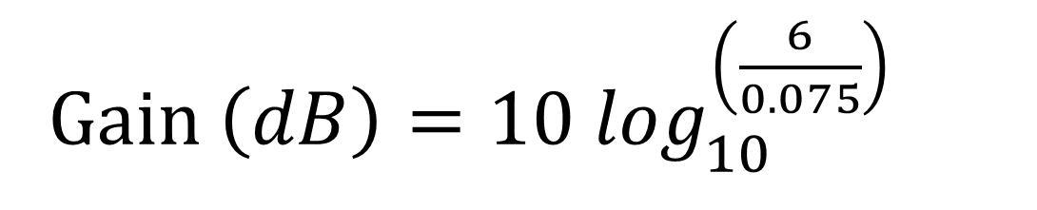

Buda Tech
Gain $\left(dB\right)=10 \log_{10}^{\left(\frac{Pout}{Pin}\right)}$
Gain $\left(dB\right)=10 \log_{10}^{\left(\frac{6}{0.075}\right)}$
Gain $\left(dB\right)=10 \log_{10}^{\left(80\right)}$

Slide 22





Buda Tech
Gain$\left(dB\right)=10 \log_{10}^{\left(80\right)}$
Gain $\left(dB\right)=10\left(\frac{\log{80}}{\log{10}}\right)$
Gain $\left(dB\right)=10\left(\frac{1.9031}{1}\right)$
Gain $\left(dB\right)=10\left(1.9031\right)$
Gain $\left(dB\right)=19dB$

Slide 23
Buda Tech
Example Three cascade amplifiers with input power of 40mW have gains 5, 2 and 17 respectively, what is the total gain in dB and output power
Pin= 40mW
Pout = ?
G=5
G=2
G=17

Slide 24
Buda Tech
Pin= 40mW
G1=5
G2=2
G3=17
Total gain = G1 x G2 x G3
Total gain = 5 x 2 x 17 =170

Slide 25


Buda Tech
Gain is the ratio of output power to input power
$\frac{Pout}{P.in}$ = Gain
Gain $\left(dB\right)=10 \log_{10}^{\left(\frac{Pout}{Pin}\right)}$
Gain $\left(dB\right)=10 \log_{10}^{\left(Gain\right)}$

Slide 26

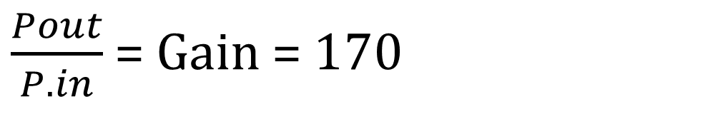


Buda Tech
$\frac{Pout}{P.in}$ = Gain = 170
Gain $\left(dB\right)=10 \log_{10}^{\left(\frac{Pout}{Pin}\right)}$
Gain $\left(dB\right)=10 \log_{10}^{\left(170\right)}$
Gain $\left(dB\right)=10\left(\frac{\log{170}}{\log{10}}\right)$

Slide 27




Buda Tech
Gain $\left(dB\right)=10\left(\frac{\log{170}}{\log{10}}\right)$
Gain $\left(dB\right)=10\left(2.2304\right)$
Gain $\left(dB\right)=10\left(2.2304\right)$
Gain $\left(dB\right)=22.3dB$

Slide 28

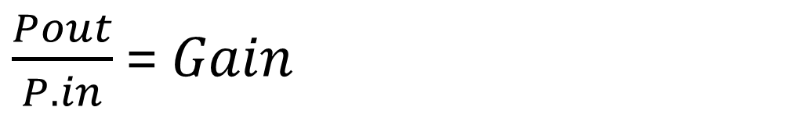


Buda Tech
Pin= 40mW
G1=5
G2=2
G3=17
Total gain = G1 x G2 x G3
$\frac{Pout}{P.in}$ = $Gain$
Total gain = 5 x 2 x 17 =170
$$Pout=Gain x Pin$$
$$Pout=170 x 40mW$$
$$Pout=6.8W$$

Slide 29
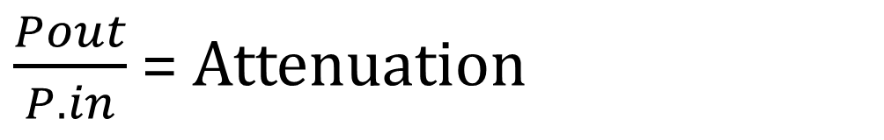
Buda Tech
Example
A filter has a input power of 50mW and output power
2mW, what is the attenuation in decibel
$\frac{Pout}{P.in}$ = Attenuation
50mW
2mW
Filter

Slide 30
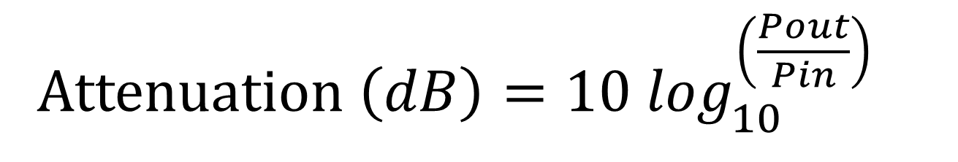
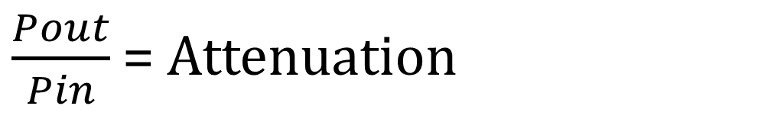
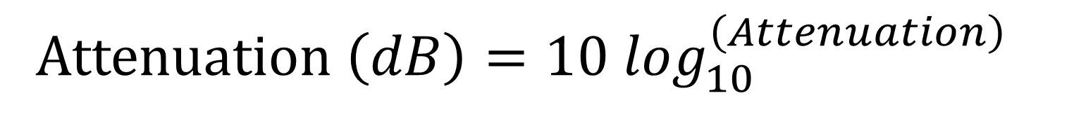
Buda Tech
Attenuation is the reduction in signal strength or power as
it travels through a medium
$\frac{Pout}{Pin}$ = Attenuation
Attenuation $\left(dB\right)=10 \log_{10}^{\left(\frac{Pout}{Pin}\right)}$
Attenuation $\left(dB\right)=10 \log_{10}^{\left(Attenuation\right)}$

Slide 31

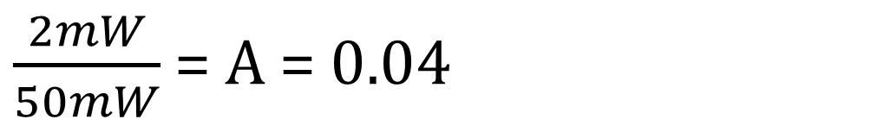
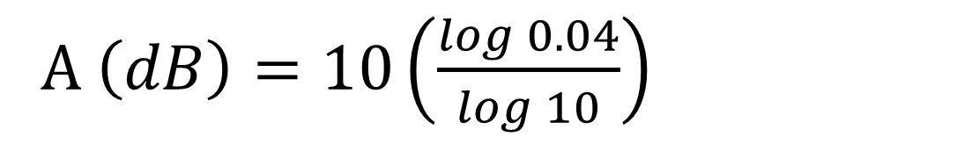

Buda Tech
$\frac{2mW}{50mW}$ = A = 0.04
Attenuation $\left(dB\right)=10 \log_{10}^{\left(0.04\right)}$
Attenuation $\left(dB\right)=10 \log_{10}^{0.04}$
A $\left(dB\right)=10\left(\frac{\log{0.04}}{\log{10}}\right)$

Slide 32
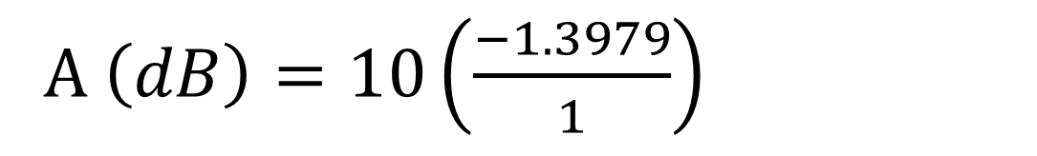
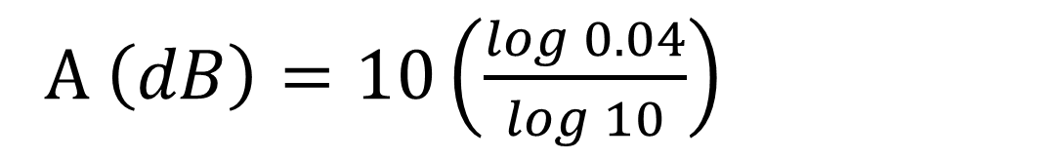

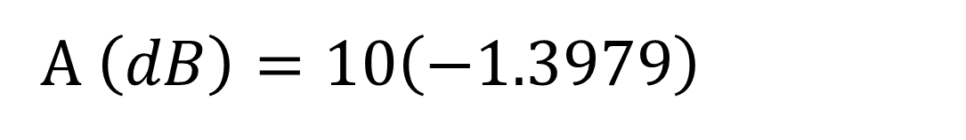
Buda Tech
A $\left(dB\right)=10\left(\frac{\log{0.04}}{\log{10}}\right)$
A $\left(dB\right)=10\left(\frac{−1.3979}{1}\right)$
A $\left(dB\right)=10\left(−1.3979\right)$
Attenuation $=−13.979dB$

Slide 33
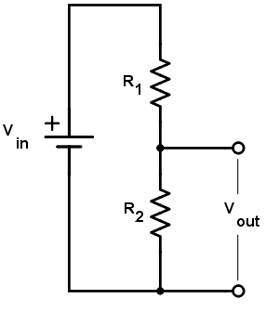
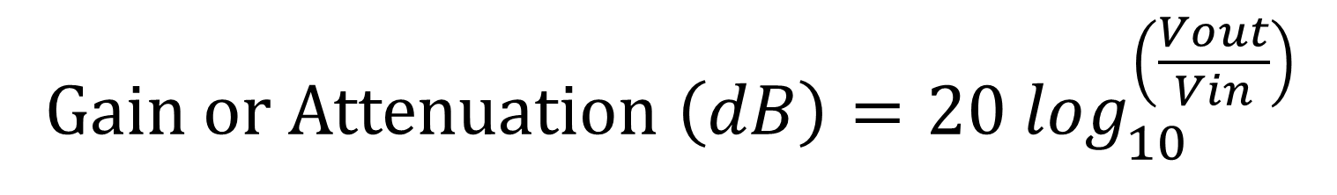
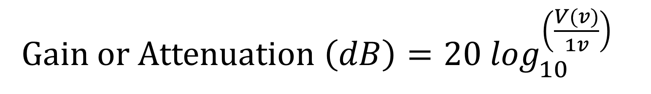
Buda Tech
Voltage Gain, Attenuation
Decibel dB
Gain or Attenuation $\left(dB\right)=20 \log_{10}^{\left(\frac{V(v)}{1v}\right)}$
Gain or Attenuation $\left(dB\right)=20 \log_{10}^{\left(\frac{Vout}{Vin}\right)}$

Slide 34
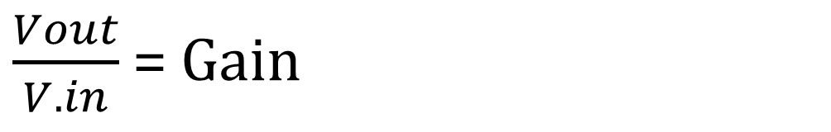
Buda Tech
Gain is the ratio of output voltage to input voltage
$\frac{Vout}{V.in}$ = Gain
Vin
Vout
Amplification

Slide 35
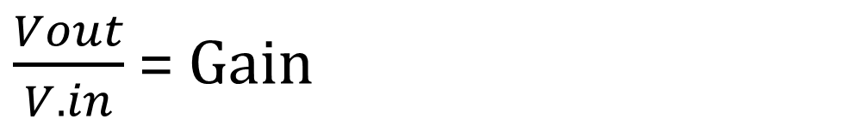
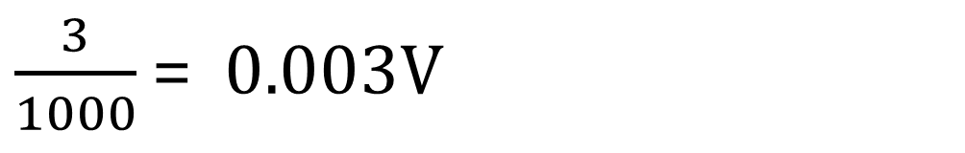
Buda Tech
Example
An amplifier has a input voltage of 3mV and output voltage
5V, what is the gain in decibel
$\frac{Vout}{V.in}$ = Gain
$\frac{3}{1000}$ = 0.003V

Slide 36
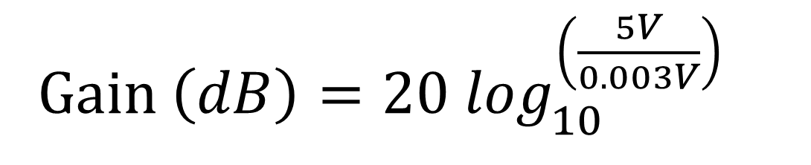

Buda Tech
Gain is the ratio of output voltage to input voltage
$\frac{Vout}{V.in}$ = Gain
Gain $\left(dB\right)=20 \log_{10}^{\left(\frac{5V}{0.003V}\right)}$
Gain $\left(dB\right)=20 \log_{10}^{\left(1667\right)}$

Slide 37




Buda Tech
Gain $\left(dB\right)=20\left(\frac{\log{1667}}{\log{10}}\right)$
Gain $\left(dB\right)=20\left(3.2218\right)$
Gain $\left(dB\right)=20\left(3.2218\right)$
Gain $\left(dB\right)=64.43dB$

Slide 38
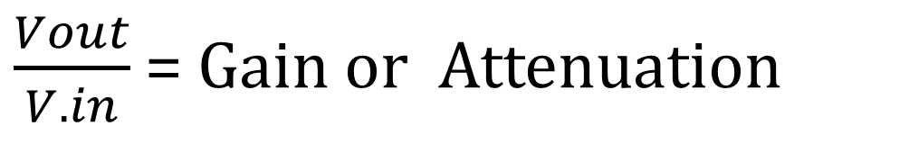

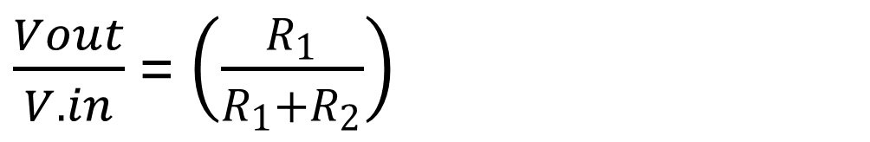

Buda Tech
VOLTAGE DIVIDER ATTENUATION
A voltage divider introduces attenuation
Vout = Vin$\left(\frac{R_{1}}{R_{1}+R_{2}}\right)$
$\frac{Vout}{V.in}$ = Gain or Attenuation
$\frac{Vout}{V.in}$ = $\left(\frac{R_{1}}{R_{1}+R_{2}}\right)$
$Attenuation$ = $\left(\frac{R_{1}}{R_{1}+R_{2}}\right)$

Slide 39
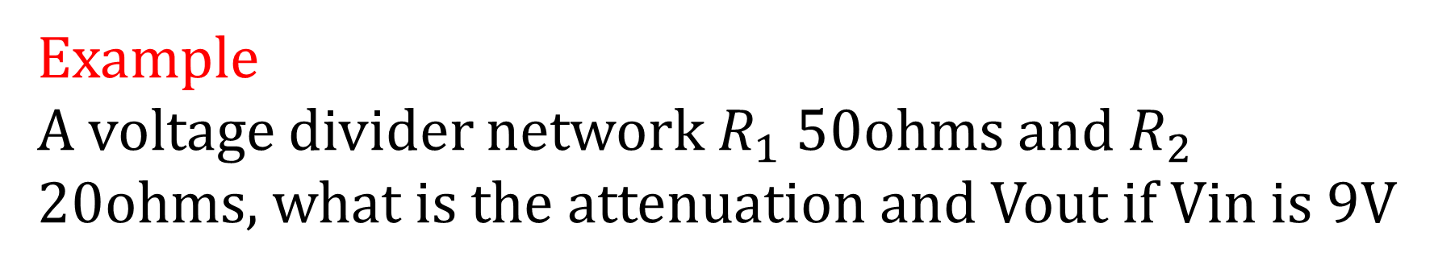
Buda Tech
Example
A voltage divider network $R_{1}$ 50ohms and $R_{2}$ 20ohms, what is the attenuation and Vout if Vin is 9V
20ohms
50ohms
9

Slide 40

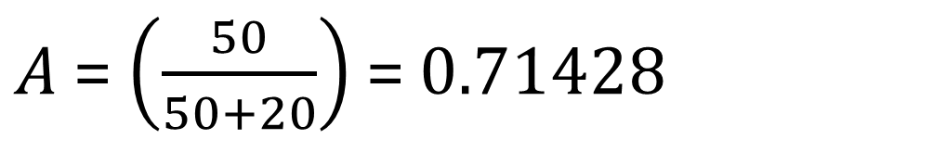
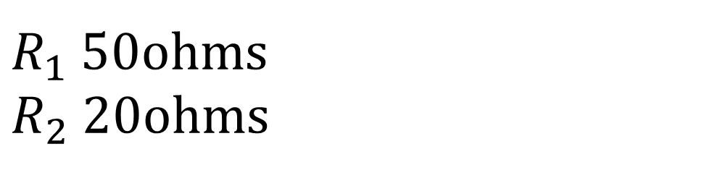
Buda Tech
20ohms
$R_{1}$ 50ohms
$R_{2}$ 20ohms
50ohms
$Attenuation$ = $\left(\frac{R_{1}}{R_{1}+R_{2}}\right)$
$A$ = $\left(\frac{50}{50+20}\right)$ = 0.71428

Slide 41




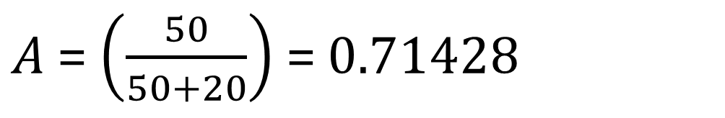
Buda Tech
20ohms
$Vout$ = Vin$\left(\frac{R_{1}}{R_{1}+R_{2}}\right)$
50ohms
9
$A$ = $\left(\frac{50}{50+20}\right)$ = 0.71428
$Vout$ = Vin$\left(0.71428\right)$
$Vout$ = 9V x $\left(0.71428\right)$
$Vout$ = 6.4286V

Slide 42
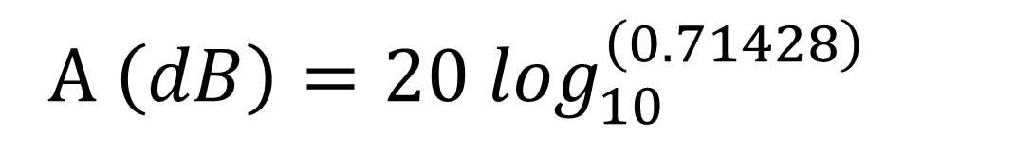
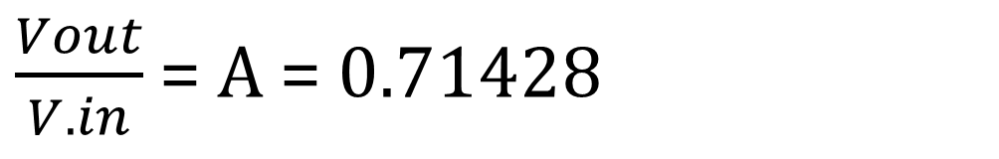
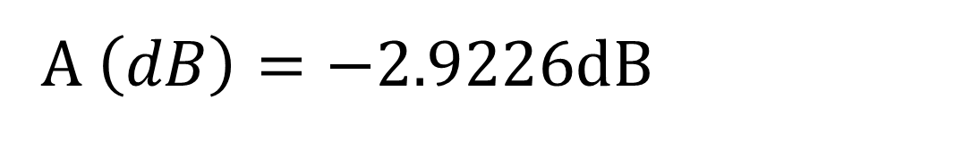
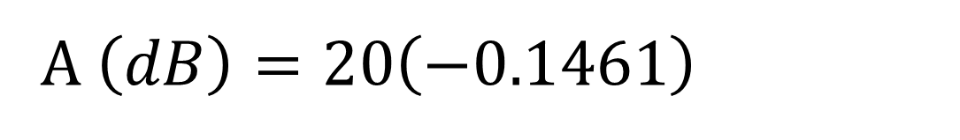
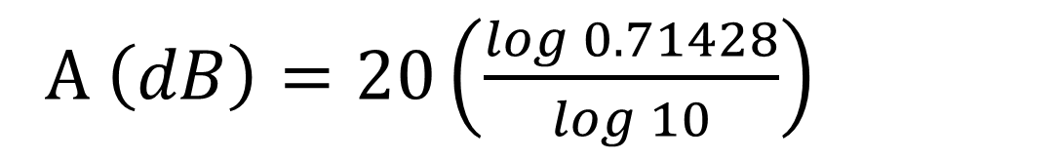
Buda Tech
$\frac{Vout}{V.in}$ = A = 0.71428
A $\left(dB\right)=20 \log_{10}^{\left(0.71428\right)}$
A $\left(dB\right)=20\left(\frac{\log{0.71428}}{\log{10}}\right)$
A $\left(dB\right)=20\left(−0.1461\right)$
A $\left(dB\right)=−2.9226dB$

Slide 43
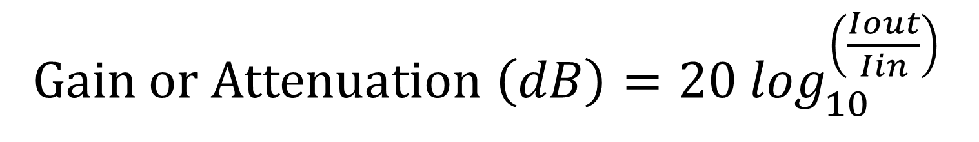
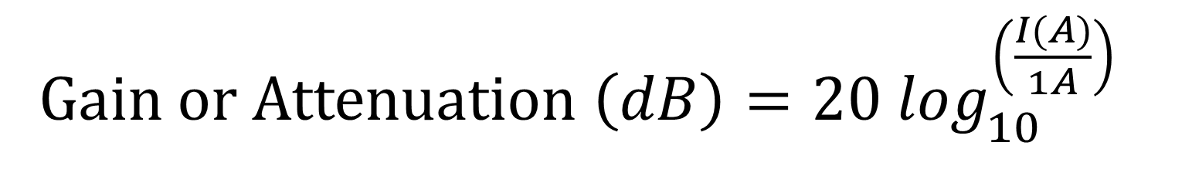
Buda Tech
Current Gain, Attenuation
in dB
Gain or Attenuation $\left(dB\right)=20 \log_{10}^{\left(\frac{I(A)}{1A}\right)}$
Gain or Attenuation $\left(dB\right)=20 \log_{10}^{\left(\frac{Iout}{Iin}\right)}$

Slide 44
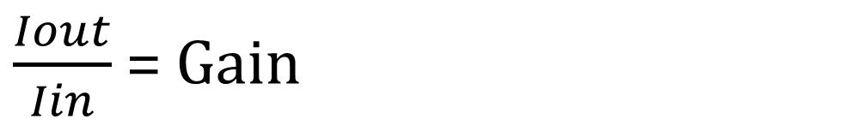
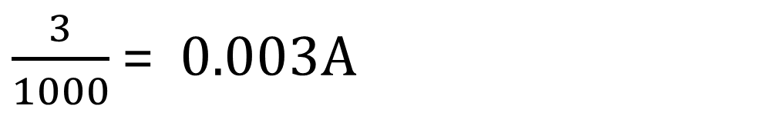
Buda Tech
Example
An amplifier has a input current of 3mA and output current
5A, what is the gain in decibel
$\frac{Iout}{Iin}$ = Gain
$\frac{3}{1000}$ = 0.003A

Slide 45
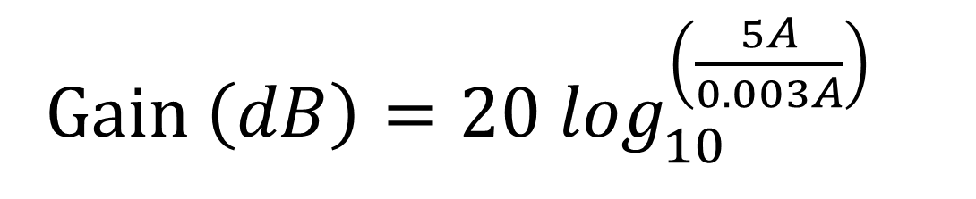
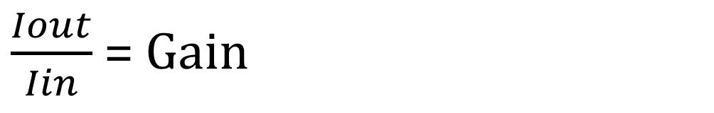
Buda Tech
Gain is the ratio of output current to input current
$\frac{Iout}{Iin}$ = Gain
Gain $\left(dB\right)=20 \log_{10}^{\left(\frac{5A}{0.003A}\right)}$
Gain $\left(dB\right)=20 \log_{10}^{\left(1667\right)}$

Slide 46
Buda Tech
Gain $\left(dB\right)=20\left(\frac{\log{1667}}{\log{10}}\right)$
Gain $\left(dB\right)=20\left(3.2218\right)$
Gain $\left(dB\right)=20\left(3.2218\right)$
Gain $\left(dB\right)=64.43dB$

Slide 47
CURRENT ATTENUATION
Buda Tech
Iin= 3A
Stage 1
Stage 2
Stage 3
A1=0.06
A2=0.2
A3=0.9
Total Attenuation = A1 x A2 x A3
Total A = 0.06 x 0.2 x 0.9 = 0.0108
Total A = 0.06 x 0.2 x 0.9 = 0.0108

Slide 48
Buda Tech
Iin= 3A
A1=0.06
A2=0.2
A3=0.9
A = 0.06 x 0.2 x 0.9 = 0.0108
Iout = 0.0108 x 3
Iout = 0.0108 x 3
Iout = 32.4mA

Slide 49
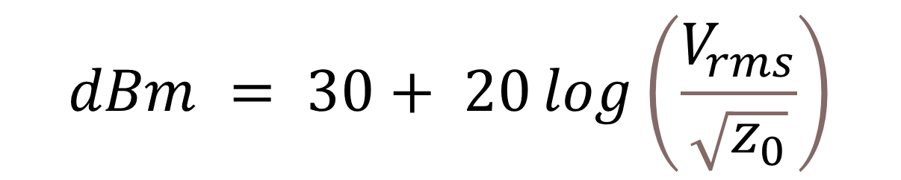
Buda Tech
Power in V(rms) to dBm
$$dBm = 30+ 20\log\left(\frac{V_{rms}}{\sqrt{z_{0}}}\right)$$

Slide 50
Buda Tech
Example
An amplifier has a input voltage of 3mA and output current
5A, what is the gain in decibel
$\frac{Iout}{Iin}$ = Gain
$\frac{3}{1000}$ = 0.003A

